Slide 1

COMPUTER TROUBLESHOOTING training v2.0
This guide is for TECHNICAL SUPPORT who wants to learn more about desktop and laptop system.
Please use this as your personal guide.
JOMAR NOBLEZA
TECHNICAL LEAD
CCNA/CCDA/MCTS/MCSA/MCITP/VMCA/CYB/CHS-NCII
You Can't Keep It Unless You Give It Away.

Slide 2
TOPICS
INSIDE A COMPUTER
MOTHERBOARD PARTS
PROCESSORS
MEMORY
VIDEOCARDS
HARD DRIVES

Slide 3
INSIDE A COMPUTER
POWER SUPPLY
DVD
MOTHERBOARD
FDD
HDD
VIDEO / AUDIO /
NETWORK CARD
WIRES and
CABLES
COMPUTER CASE

Slide 4
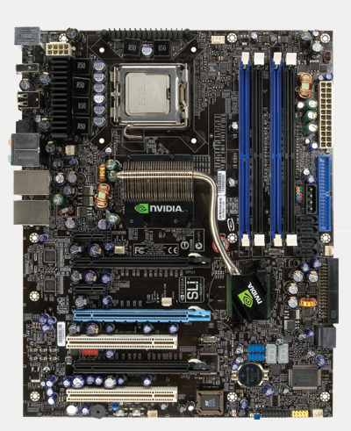
MOTHERBOARD PARTS
CPU SOCKET
ATX POWER
CONNECTOR
NORTH BRIDGE
MEMORY SLOT
PCI EXPRESS SLOT
IDE
PCI SLOT
SATA PORTS
BIOS CHIP
SOUTH BRIDGE
BACK PANEL CONNECTORS
CMOS BATTERY
SYSTEM PANEL CONNECTORS

Slide 5
MOTHERBOARD
The most important part of a PC is the motherboard. It holds:
the processor chip
memory chips
chips that handle input/output (I/O)
the expansion slots for connecting peripherals
The shape and layout of a motherboard is called the form factor. The form factor affects where individual components go and the shape of the computer's case.
Chipsets
The chipset is the "glue" that connects the microprocessor to the rest of the motherboard and therefore to the rest of the computer. On a PC, it consists of two basic parts -- the northbridge and the southbridge. All of the various components of the computer communicate with the CPU through the chipset

Slide 6
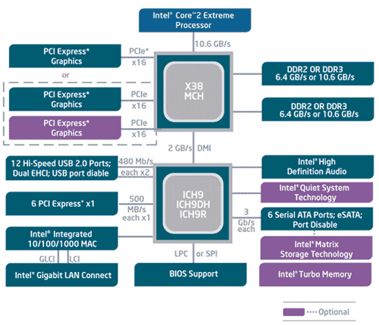
CHIPSETS
Bus speed usually refers to the speed of the front side bus (FSB), which connects the CPU to the northbridge.
FSB speeds up to 10.6 GB/s.
The northbridge connects directly to the processor via the front side bus (FSB). A memory controller is located on the northbridge, which gives the CPU fast access to the memory. The northbridge also connects to the AGP or PCI Express bus and to the memory itself.
The southbridge is slower than the northbridge, and information from the CPU has to go through the northbridge before reaching the southbridge. Other busses connect the southbridge to the PCI bus, the USB ports and the IDE or SATA hard disk connections.

Slide 7
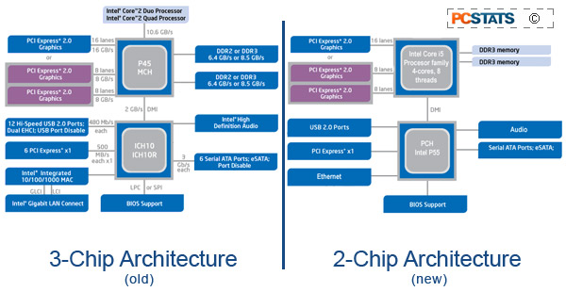
CHIPSETS
The main difference between the two is that tasks previously handed by the Northbridge chipset have been rolled into the Core i5 processor.

Slide 8
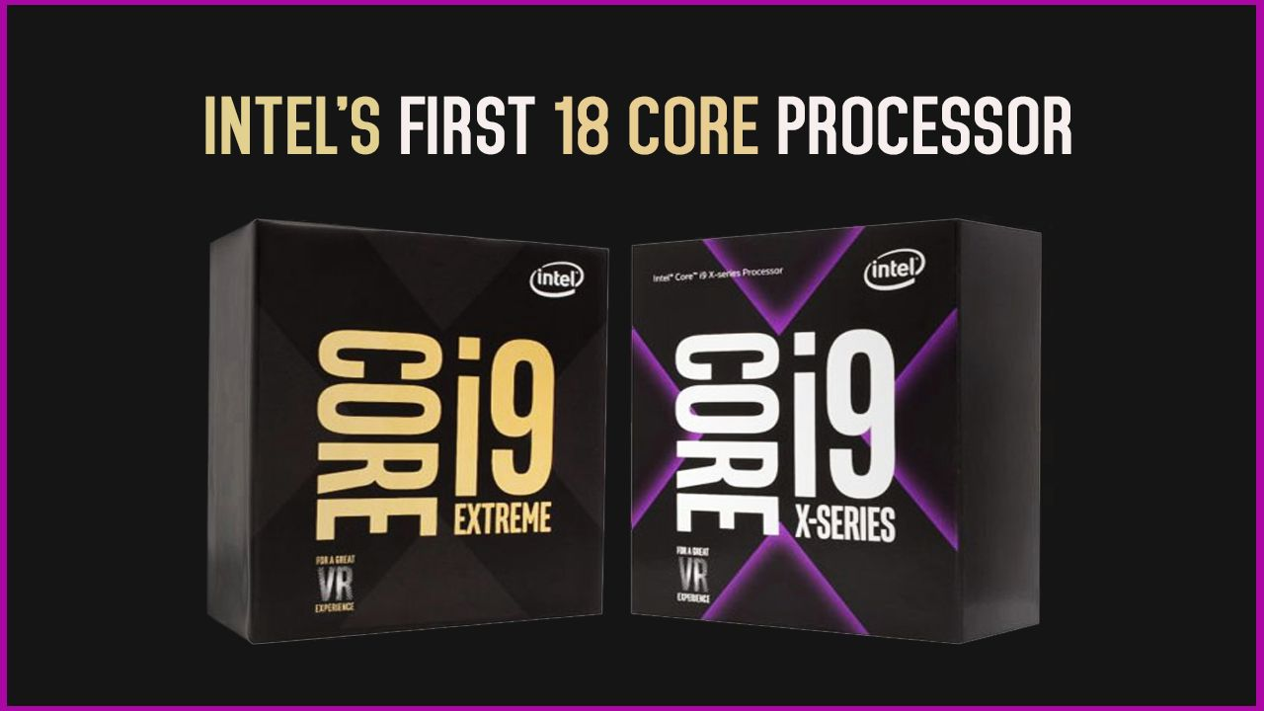
PROCESSOR
also known as a CPU
Stands for "Central Processing Unit."
The CPU is the primary component of a computer that processes instructions.
The CPU contains at least one processor, which is the actual chip inside the CPU that performs calculations.
most CPUs only had one processor, but now it is common for a single CPU to have at least two processors or "processing cores.
A CPU with two processing cores is called a dual-core CPU
with four cores are called quad-core CPUs
High-end CPUs may have six (hexa-core)
even eight (octo-core) processors
Introducing the new 9th Gen Intel® Core™ desktop processors

Slide 9
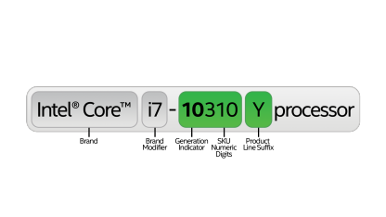
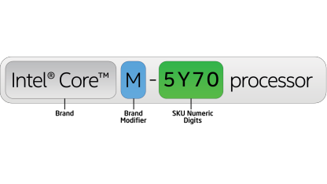
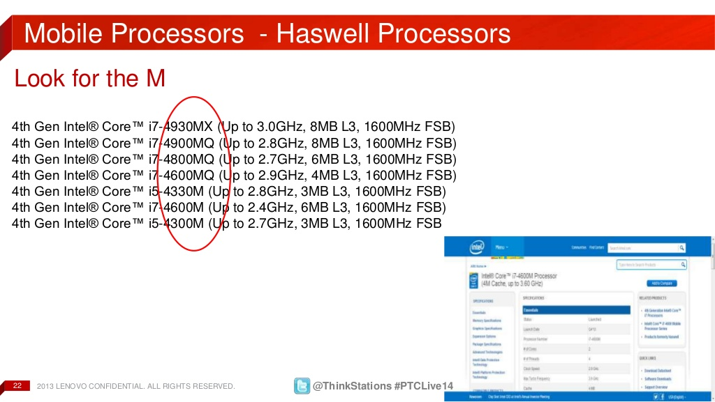
Desktop and Mobile Processors
Processor numbers in this category of the 10th Generation Intel® Core™ processors family use an alphanumeric scheme based on generation and product line details following the brand and its modifier. The first two digits in the five-number sequence indicates the generation (10th) of processor, the next three digits are SKU numbers followed by either U or Y, which represents a category of mobile system the processor is ideally suited for.

Slide 10
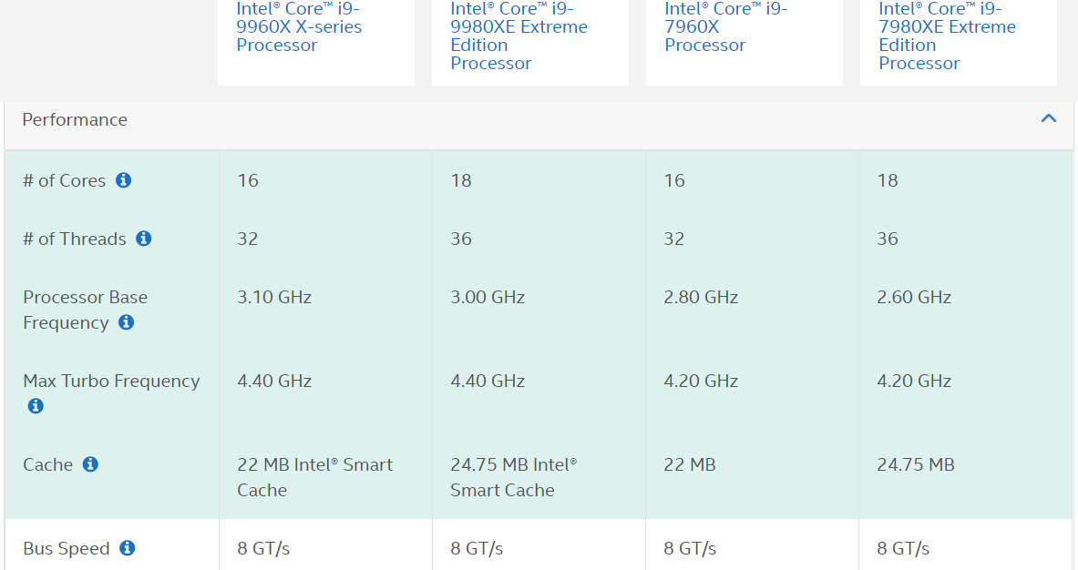

Slide 11
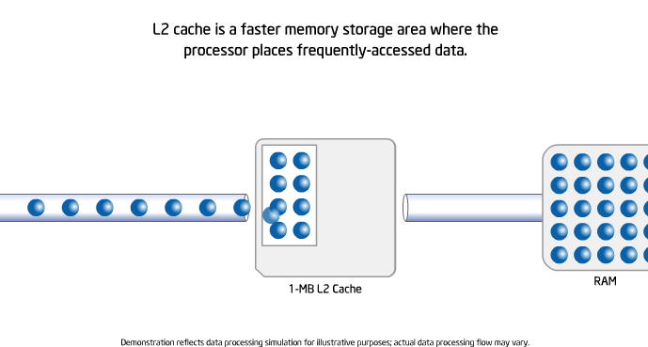
Intel Smart Cache Technology

Slide 12
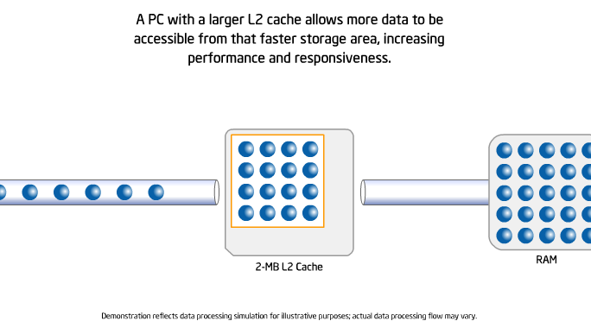
Intel Smart Cache Technology

Slide 13
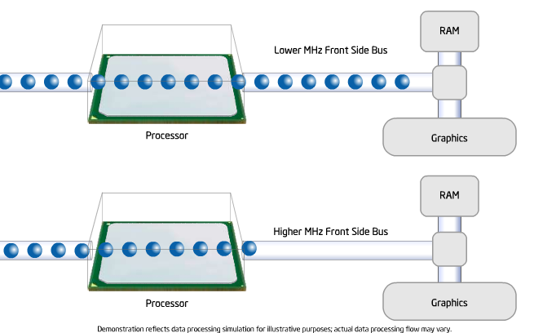
FRONT SIDE BUS

Slide 14
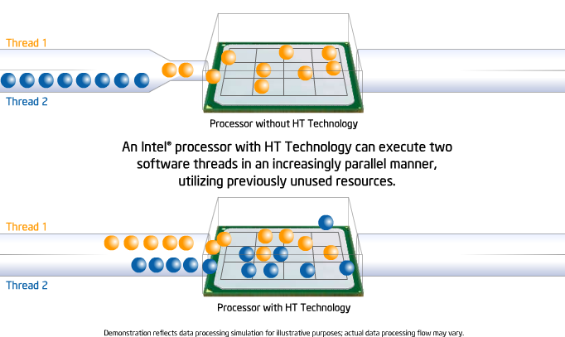
HYPER THREADING

Slide 15
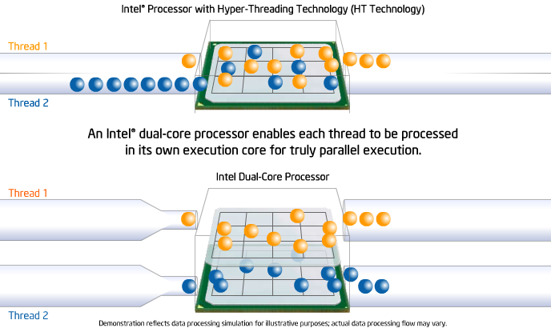
DUAL CORE

Slide 16
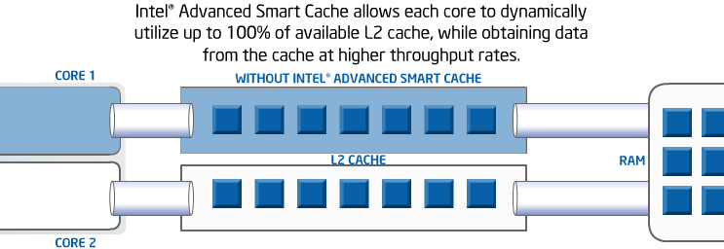
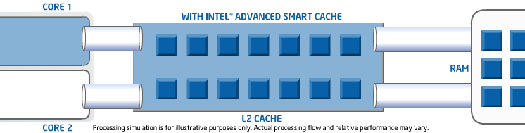
Advance l2 smart cache

Slide 17
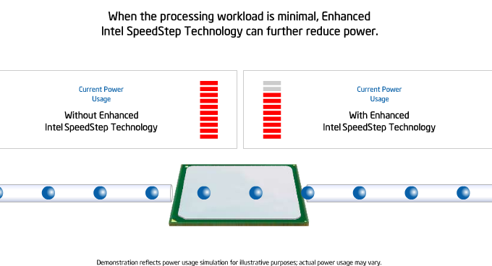
ENHANCED SPEED STEP TECHNOLOGY

Slide 18
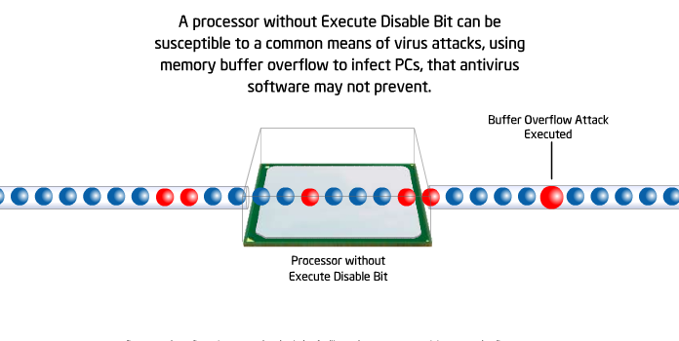
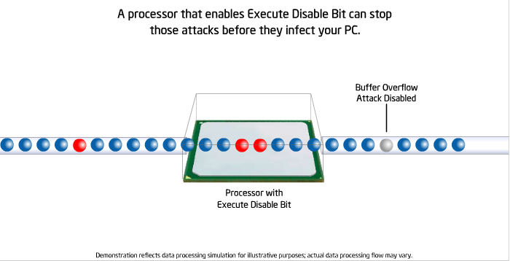
EXECUTE DISABLE BIT TECHNOLOGY

Slide 19
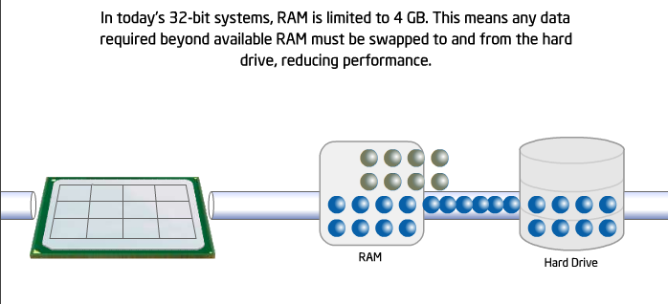
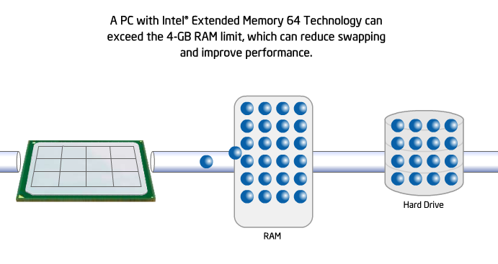
Intel Extended Memory 64 TECHNOLOGY

Slide 20
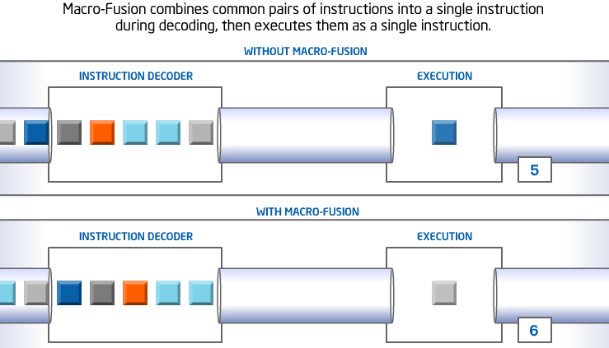
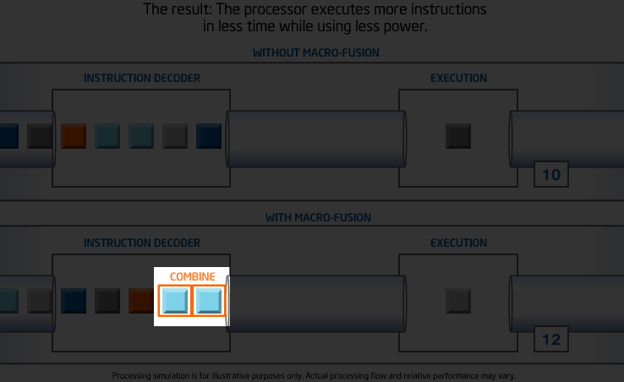
MACRO FUSION

Slide 21
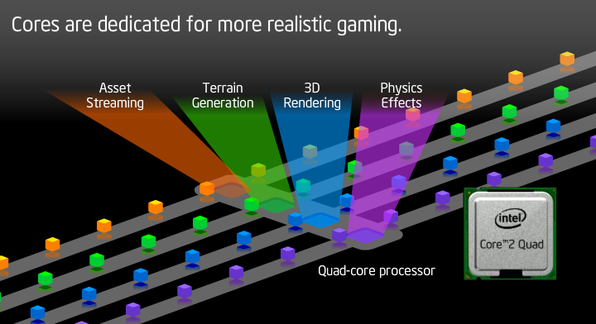
QUAD CORE

Slide 22
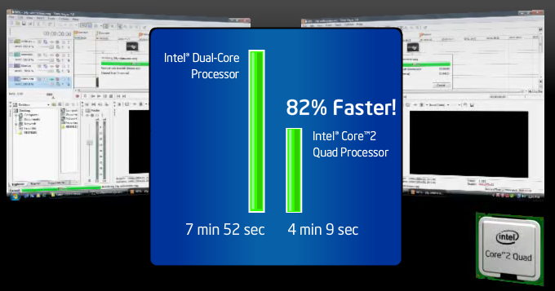
BENCHMARK

Slide 23
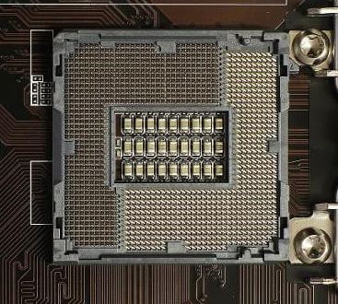
CPU SOCKETS
LGA 1150
Socket LGA 1150 is designed to accommodate the latest Haswell (4th-gen Intel Core) processors.
This socket also supports the handful of 5th-generation Core desktop chips that came to market.
Like other Intel sockets, it can be found on six different chipsets; H81, B85, Q85, Q87, H87 and Z87. The first trio (H81, B85 and Q85) can be considered the entry-level line.

Slide 24
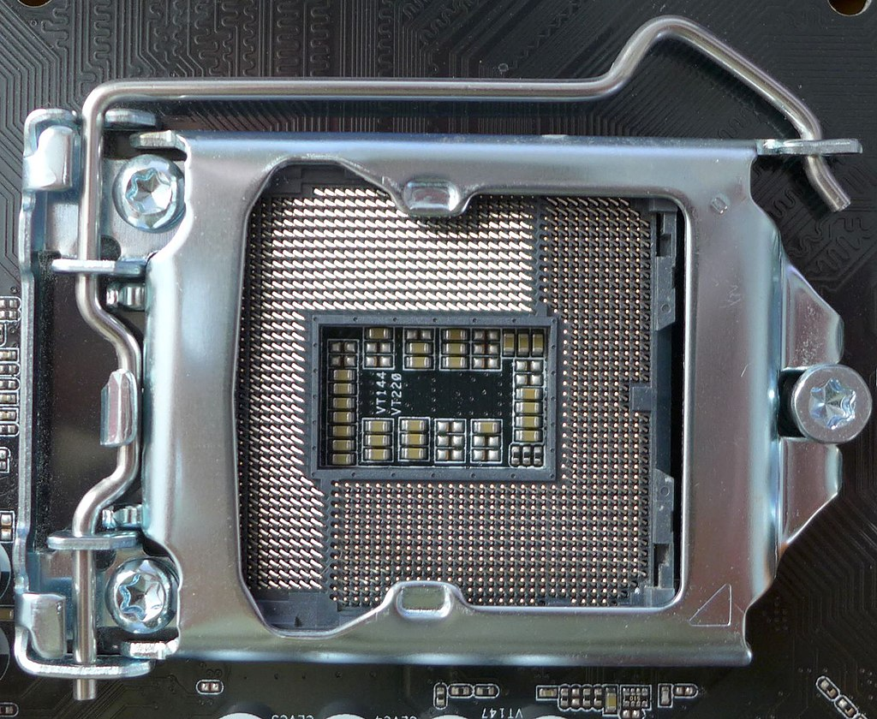
CPU SOCKETS
LGA 1151
The LGA 1151 socket was revised for the Coffee Lake generation CPUs and comes along with the Intel 300-series chipsets
adding power and ground lines to support the requirements of 6-core and 8-core CPUs

Slide 25
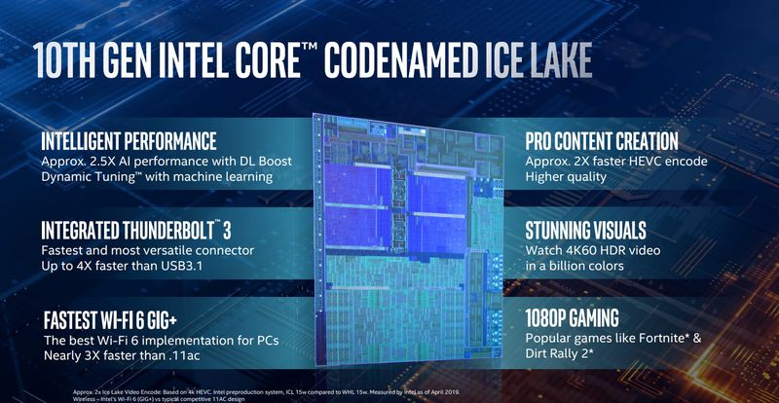
Intel’s 10th Gen, 10nm Ice Lake CPUs

Slide 26
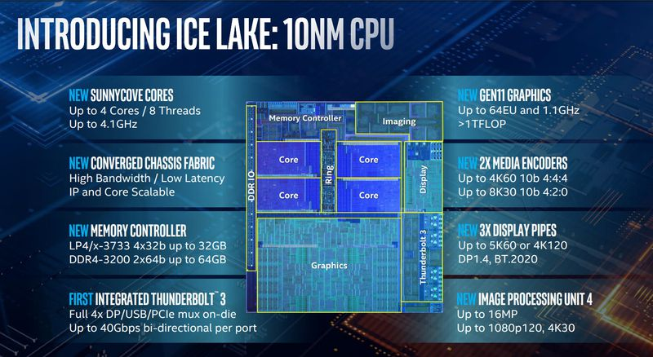
Intel’s 10th Gen, 10nm Ice Lake CPUs

Slide 27
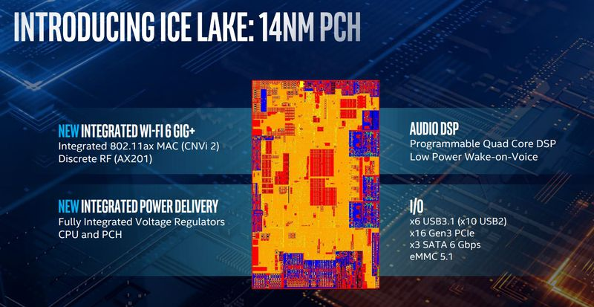
Intel’s 10th Gen, 10nm Ice Lake CPUs

Slide 28
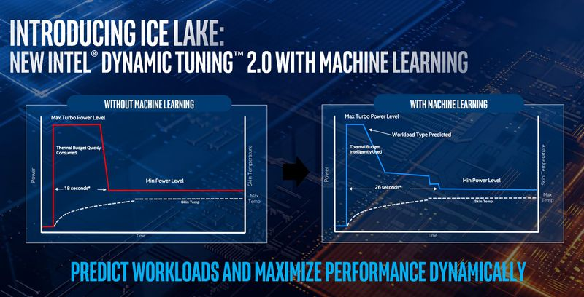
Intel’s 10th Gen, 10nm Ice Lake CPUs

Slide 29
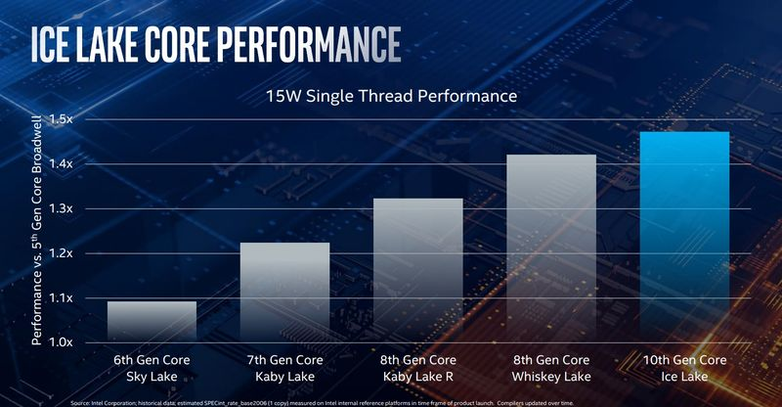
Intel’s 10th Gen, 10nm Ice Lake CPUs

Slide 30
Intel’s 10th Gen, 10nm Ice Lake CPUs

Slide 31
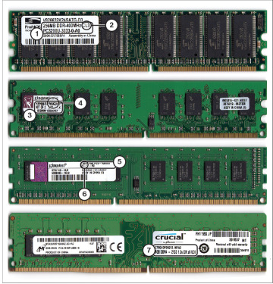
MEMORY
RAM Memory: Random access memory (RAM) is a series of small cards or modules plugged into slots on the motherboard.
The CPU can request any data in RAM. It is then located, opened, and delivered to the CPU for processing in a few billionths of a second. Since all the contents of RAM are erased when you turn off the computer, RAM is the temporary or volatile storage location for the computer.

Slide 32
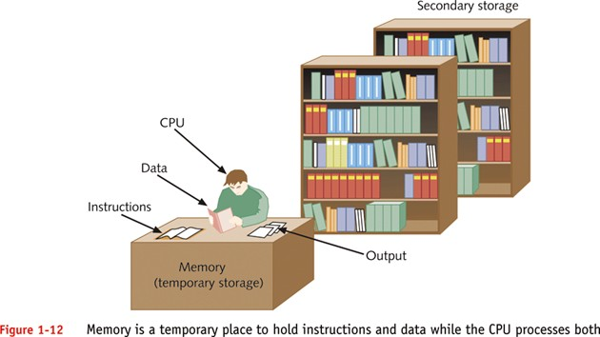

Slide 33
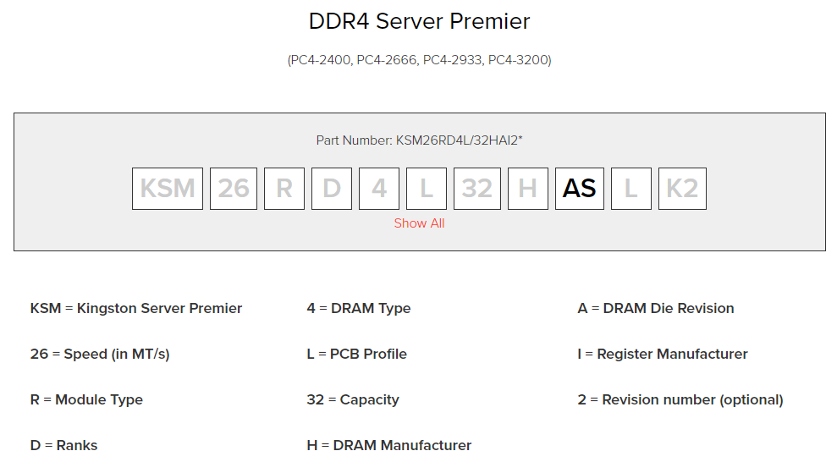
MEMORY

Slide 34
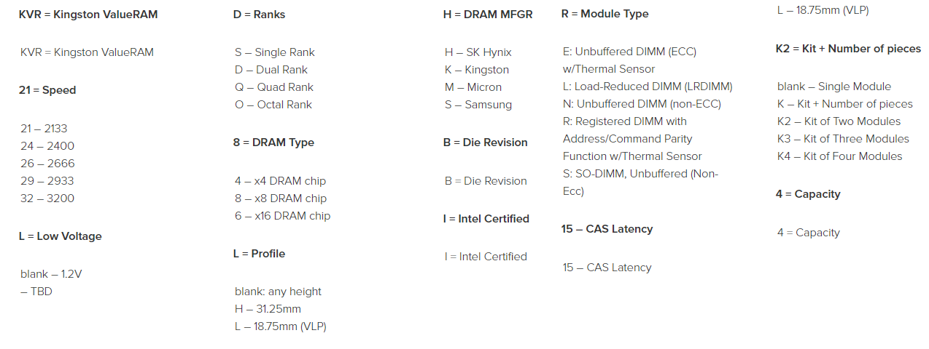
MEMORY

Slide 35
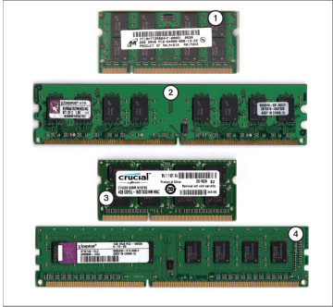
MEMORY
ECC vs non-ECC Memory
For critical applications, network servers have long used a special type of memory called error-correcting code (ECC).
This memory enables the system to correct single-bit errors and notify you of larger errors.
SO-DIMM vs DIMM
Most desktop computers use full-sized memory modules known asDIMMs. However, laptop computers and some small-footprint mini-ITX motherboards and systems use reduced-size memory modules known as small outline DIMMs (SO-DIMMs or SODIMMS).

Slide 36
MEMORY
From top to bottom, desktop memory modules: DDR, DDR2, DDR3, and DDR4 DIMM.
1. 256MB DDR module, PC3200 (DDR400)
2. CL3 latency
3. 2GB DDR2 module (from matched set),
DDR2-667 (PC2-5300)
4. CL5 latency
5. 2GB DDR3 module, PC3-10600 (DDR3-1333)
6. CL9 latency
7. 8GB DDR4 module, DDR4-2133 (PC4-17000)

Slide 37
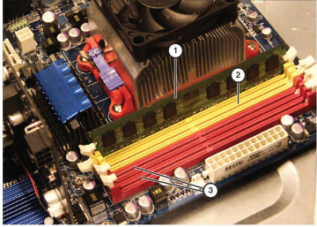
MEMORY
To use dual-channel operation on this motherboard, add an identical module to the light-colored memory socket.
1. Installed DIMM
2. Install identical module here for dual-channel
operation
Use a matched pair (same speed and CAS latency (CL) as the first pair) in these sockets for best performance.
This pair need not be the same size as the first
pair.

Slide 38
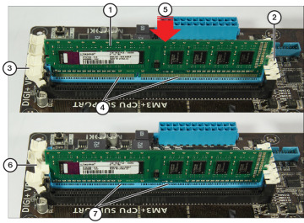
MEMORY installation
A DDR3 DIMM partly inserted (top) and fully inserted (bottom). The memory module must be pressed firmly into place before the locking tab (left) will engage.
1. DDR3 module lined up for installation
2. any recent motherboards use fixed guides on one side.
3. motherboards have at least one locking tab per module.
4. connectors visible when module is not fully inserted.
5. Push module firmly into place.
6. Locking tab holds module in place when fully installed.
7. connectors are no longer visible when module is fully inserted.

Slide 39
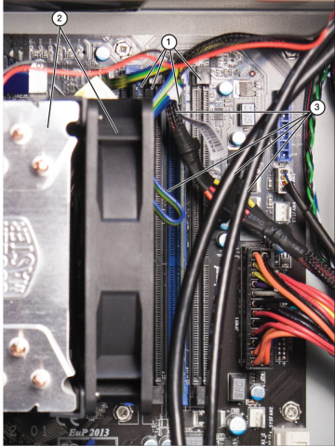
MEMORY
DIMM sockets in a typical system are often surrounded and covered up by power and data cables or aftermarket CPU fans and heat sinks, making it difficult to properly install additional memory.
1. Memory sockets (some blocked by fan and heat sink)
2. aftermarket fan and heat sink for CPU
3. power and data cables

Slide 40
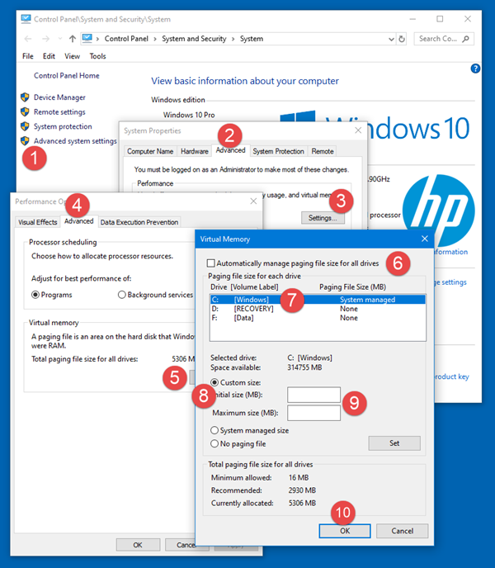
MEMORY – PAGE FILE
the system commit charge is more than 90 percent of the system commit limit, the page file is increased to back it.
This continues to occur until the page file reaches three times the size of physical memory or 4 GB, whichever is larger.
This all assumes that the logical disk that is hosting the page file is large enough to accommodate the growth.

Slide 41
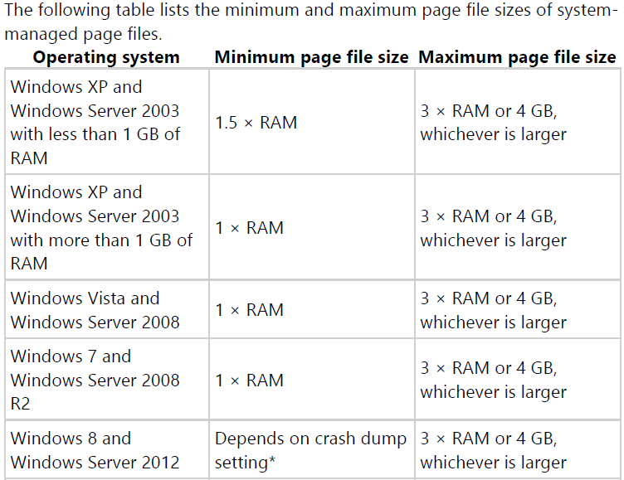
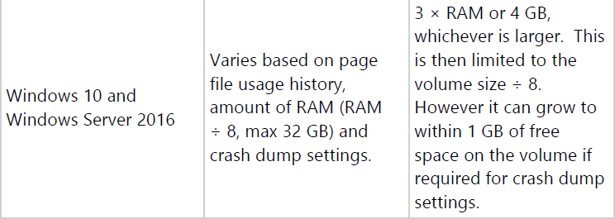
MEMORY – PAGE FILE

Slide 42
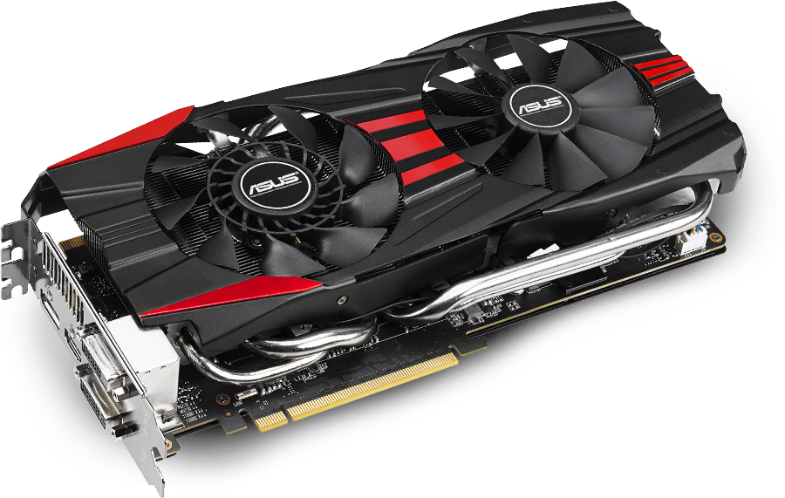
VIDEO CARD
graphics card (also called a video card or GPU) is a device which generates and outputs images on the display of the computer.
Gpu’s are non-essential to a functioning computer but very useful for gamers, studio development, and different types of editing, animation and cad development.

Slide 43
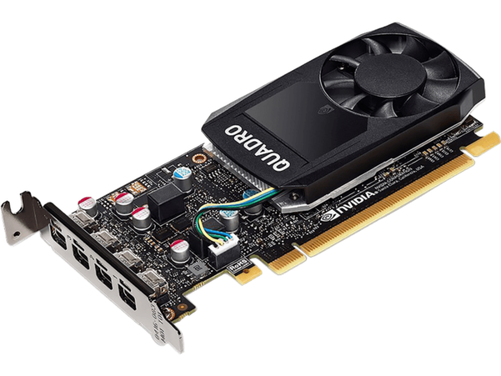
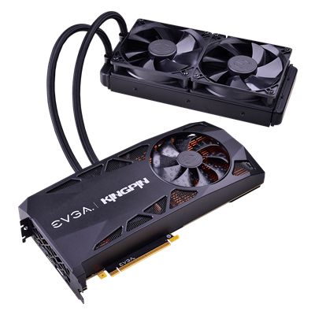
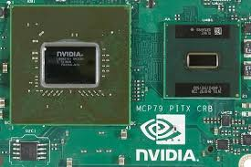
VIDEO CARD
Different types of GPUs
Integrated Graphics
Dedicated Graphics Card
Hybrid Graphics
Connection to the motherboard
Peripheral Component interconnect (PCI)
ADVANCED GRAPHICS PORT (AGP)
PCI EXPRESS (PCIe)

Slide 44
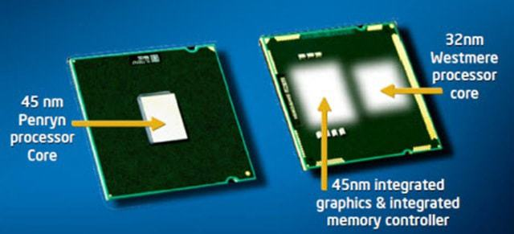
VIDEO CARD
Integrated Graphics Card
Integrated or on-board graphics are built in to the motherboard or CPU.
refers to the scenario in which you find both a CPU and a GPU included on the same chip.
Integrated graphics use a portion of a computer's system RAM instead of their own dedicated memory
Integrated graphics are less powerful than discrete graphics, but conserve energy.
Intel HD Graphics Supported with Intel Core i3 Processors and above.

Slide 45
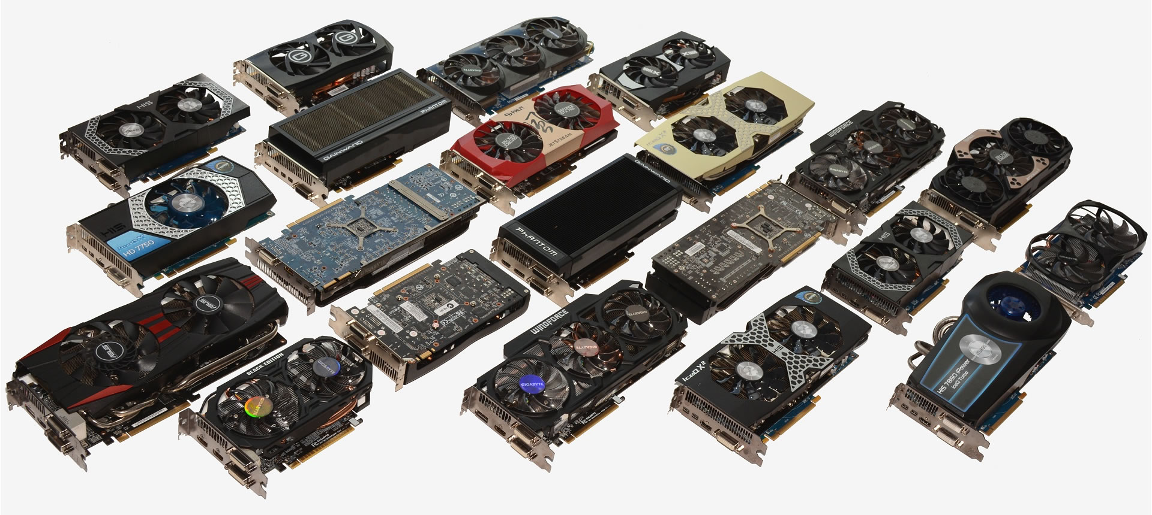
VIDEO CARD
Dedicated Graphics Card
also called a discrete graphics card on laptops.
uses its own dedicated, inbuilt memory, or RAM, leaving the system RAM for other functions.

Slide 46
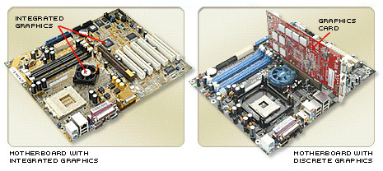
VIDEO CARD
Hybrid Graphics
Hybrid graphics software permits switching between integrated and discrete graphics based on how much processing power the running applications require.
Simultaneous use of integrated and discrete graphics card

Slide 47
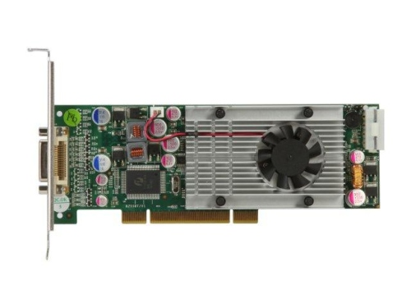

VIDEO CARD
Peripheral component interconnect (PCI)
Advanced graphics port (AGP)

Slide 48


VIDEO CARD
PCI Express (PCIe)

Slide 49

VIDEO CARD slot

Slide 50
VIDEO CARD
SHARE VIDEO TECHNOLOGY IN MOBILE NOTEBOOKS
SMA – Share Memory Architecture
2D GRAPHICS
Up to 64mb shared
UMA – Unified Memory Architecture
2D/3D GRAPHICS
Up to 128/256mb shared
DVMT – Dynamic Video Memory Technology
2D/3D GRAPHICS
Up to 128mb/256mb Dynamic Sharing
Intel Technology
Turbo Cache Technology
2D/3D GRAPHICS
Up to 128mb/256mb depends on the RAM
Nvidia Technology

Slide 51
VIDEO CARD
NVIDIA SLI
SLI or Scalable Link Interface is a multi-GPU technology from Nvidia. It is based on the principle of parallel processing where two or more GPUs share the load of game or graphics application.
The first and foremost requirement of SLI is two or more identical SLI Ready Graphics Cards. This means these graphics cards should have the same GPU and Memory capacity.
2-Way SLI / 3-Way SLI / 4-Way SLI or Quad SLI
AMD Crossfire
compatible with other cards in the same family and with different RAM configurations
Newer AMD cards do not require a connector—which isn't a huge deal, but it looks cleaner and is one less link in the chain in which something can go wrong
NVIDIA's SLI is a bit more constricting, but consistent experience, while AMD is more flexible.
single-GPU solutions are better than dual-GPU solutions

Slide 52


Slide 53


Slide 54

VIDEO CARD installation

Slide 55

VIDEO CARD Interoperability

Slide 56

HARD DRIVES
A hard disk (or "hard disc" or "hard drive" or "hard disk drive") is a computer storage device that stores data on rotating magnetic surfaces.
PATA HDD
1.6w read/write
.5w idle time
4200/5400 RPM
100 MBPS Transfer Rate
2/8 MB cache
SATA HDD
2.3w read/write
5400/7200 RPM
150MBPS Transfer Rate
8MB cache

Slide 57

HARD DRIVES
Fragmented vs. Defragmented

Slide 58

POWER SUPPLY
A power supply unit (PSU) is the component that supplies power to the other components in a computer.

Slide 59


POWER SUPPLY
Laptop ADAPTOR POWER COMPUTATION

Slide 60

POWER SUPPLY – pin & connectors

Slide 61





POWER SUPPLY – pin & connectors

Slide 62

POWER SUPPLY - testing

Slide 63

FRONT PANEL connectors

Slide 64

POWER SUPPLY & connectors

Slide 65

VIDEO CONNECTORS

Slide 66

CMOS

Slide 67


BIOS
BIOS is short for Basic Input Output System.
BIOS is a firmware, in short. It is stored on a chip on the part of the computer motherboard and is basically, a set of instructions that run to help load the operating system. You OS would fail to load, if not for the BIOS!

Slide 68

Troubleshooting and maintenance
No Power
No Display/Black out
Hang/Blue Screen
Def. Keyboard
Def. Touch Pad
Def. WiFi
Battery Easily Drain

Slide 69
Troubleshooting and maintenance
KEYBOARD Problem
Use Keyboard Utility
Touch Pad Problem
Check toggle switch Touch Pad
Reinstall driver
Check touch pad cable

Slide 70
Troubleshooting and maintenance
Wifi problems
Check toggle switch for WiFi
Reinstall driver
Check WiFi card
Check the WiFi AP / router
Know the WiFi Specs

Slide 71
Troubleshooting and maintenance
BATTERY EASILY DRAIN
Know the battery specification
2200 mAh → approx 1hr
3600 mAh → approx 11/2 hr
4400 mAh → approx 2hrs
6600 mAh → approx 3hrs
Use Battery Eater Pro

Slide 72

Troubleshooting and maintenance
NO POWER
Check led light of the adaptor
Check Mainboard Connector
Check Power switch
Check Fuse – Component level
Check Chipset – Component level
NO DISPLAY/BLACK OUT
Check LCD / BUILT-IN VGA
Check Memory
Check CPU
Check BIOS
Isolate Mainboard – Component Level
**do not open if still warranty, email to supplier
** you can check all components if out of warranty

Slide 73

Troubleshooting and maintenance
VIDEO CARD OVERHEATING
Verify that the fan is working properly.

Slide 74
Troubleshooting and maintenance
Hang / blue screen
Check Software
Check Memory (HIRENS)
GOOD
FAILED
Check CPU
STRESSTEST (HIRENS)
Check BIOS UPDATE
Check HDD
HDAT (hirens)
HDD regenerator (hirens)
Check mainboard
1. Isolate Mainboard – Component Level
**do not open if still warranty, email to supplier
** you can check all components if out of warranty

Slide 75


Warranty Void (CID)
Physical damage
crack lcd
any form of misuse

Slide 76


Warranty Void (CID)

Slide 77


Warranty Void (CID)

Slide 78


Warranty Void (CID)

Slide 79
Reference
https://www.intel.com/content/www/us/en/products/processors/core/i9-processors.html
https://software.intel.com/en-us/articles/software-techniques-for-shared-cache-multi-core-systems/?wapkw=smart+cache
https://www.hardwaresecrets.com/a-complete-list-of-cpu-sockets/
https://www.intel.com/content/www/us/en/processors/processor-numbers.html
https://www.intel.com/content/www/us/en/support/articles/000017400/processors.html
https://www.slideshare.net/cadcamperformance/tips-tricks-for-selecting-a-mobile-workstation-ptc-live-2014
https://www.slideshare.net/Yfandes/troubleshooting-16626396
https://slideplayer.com/slide/4666947/
http://www.pcstats.com/articleview.cfm?articleid=2531&page=2
https://arrow.dit.ie/cgi/viewcontent.cgi?article=1003&context=schmuldissoft
http://www.pearsonitcertification.com/articles/article.aspx?p=2738309
https://www.chekyang.com/musings/2013/12/28/computer-assembly-2014-edition/
https://www.kingston.com/us/memory/memory-part-number-decoder
http://www.playtool.com/pages/vidslots/slots.html
https://www.neweggbusiness.com/a/video-card-i-o-ports-and-interfaces/id-186
https://www.notebookcheck.net/Mobile-Graphics-Cards-Benchmark-List.844.0.html
https://www.slideshare.net/JosiahLund/gpu-presentation-73593886
https://askubuntu.com/questions/805509/what-is-the-difference-between-integrated-and-discrete-graphic-cards
https://www.pcbuildadvisor.com/how-to-build-a-computer-step-by-step-infographic/
https://towardsdatascience.com/build-and-setup-your-own-deep-learning-server-from-scratch-e771dacaa252
https://lifehacker.com/the-difference-between-nvidia-sli-and-amd-crossfire-1555235577

Slide 80
Thanks
You Can't Keep It Unless You Give It Away.

